Slide 1

SPAM SMS Detection Using Naïve Bayes
Ahsanullah University of Science and Technology
Computer Science and Engineering Department
Presented By-
M Arfayet Alam - 160204019
Saiful Islam - 170104146
Mushfiqul alam - 170104120
Submitted To-
FAISAL M SHAH
Md. Tanvir Rouf Shawon

Slide 2

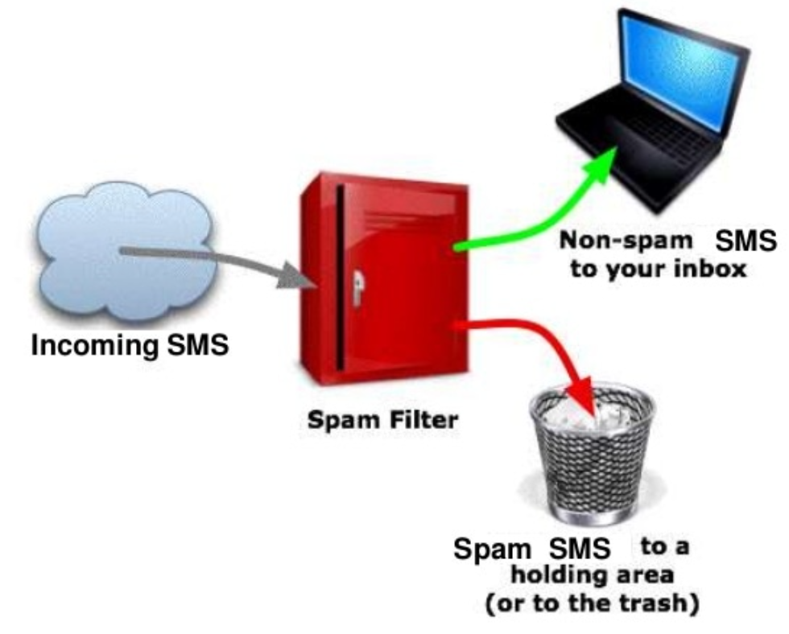



Introduction

Slide 3
Motivation
In modern times with the increased amount of mobile subscribers the ratio of spam to ham sms is very high.
Human are easily manipulated through sms.
Prediction of SPAM sms.
We will be able to easily block the spammers .
Why?

Slide 4
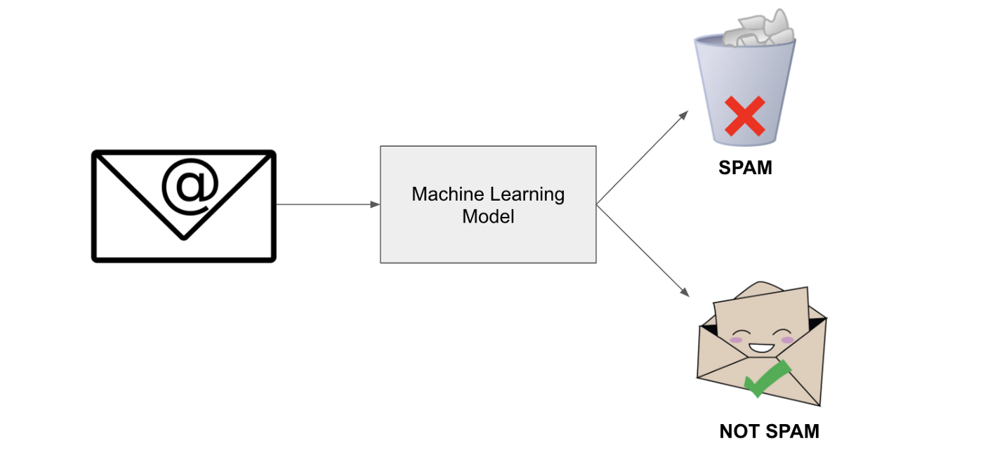
Objectives
Implementation of Naive Bayes Machine Learning Algorithm and others Machine learning Model
Data preprocessing with CountVectorizer
Implementation of Bag of Words Approach

Slide 5

Background Study
Text preprocessing libraries
Word embedding techniques
Machine learning algorithms
Classification metrics
Confusion matrix
Vectorizaion

Slide 6
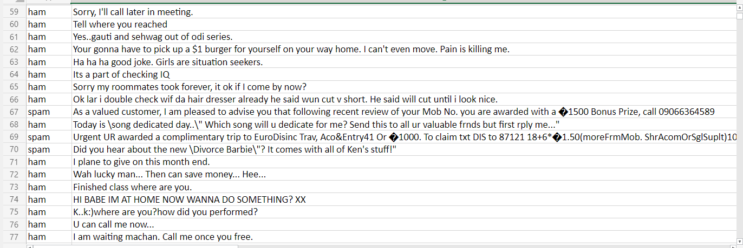
Data Acquisition
We have collected dataset from Kaggle
We used a DATA set with over 5000 SPAM and Ham data

Slide 7
Data Statistics

Slide 8
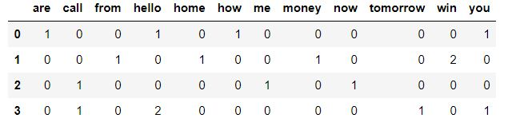
Data Statistics(Vectorization of word)

Slide 9
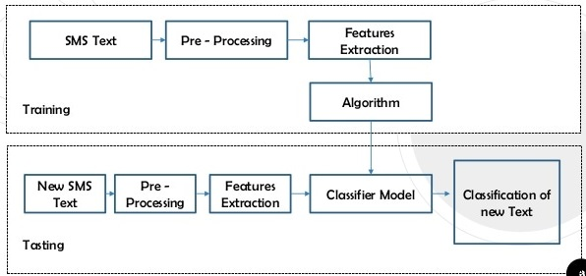
Methodologies

Slide 10

Dataset Preprocessing
Drop unnecessary colums
Dataset
Getting data length
Sorting by Frequency

Slide 11
Text Preprocessing
Normalization
Text
Vectorization
Tokenization

Slide 12
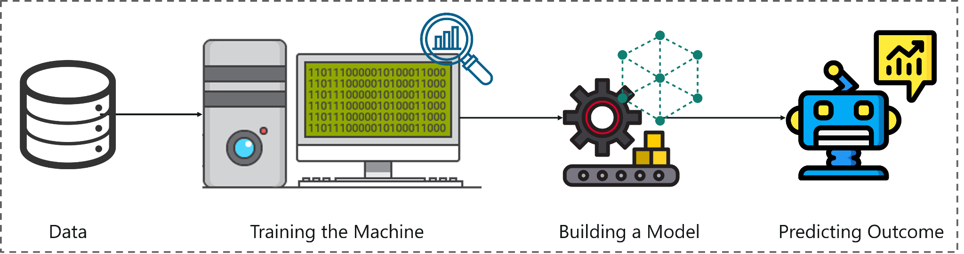
Text Classification Models
Multinomial Naive Bayes Classifier
Dense Model
LSTM Model
Bi-Lstm MOdel

Slide 13
Result Analysis
Model | Accuracy(%) | Precision(%) | Recall(%) | F1-score(%)
Multinomial Naive Bayes | 98.47 | 94.20 | 93.52 | 93.86
Dense Model | 98.41 | - | - | -
LSTM Model | 96.08 | - | - | -
BiLSTM Model | 97.30 | - | - | -

Slide 14
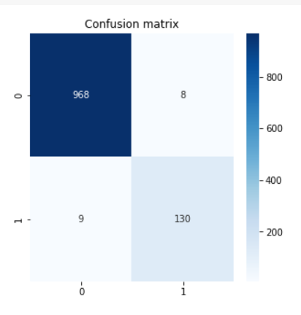
Model Perfomance:Multinomial Naïve Bayes Accuracy:98.47

Slide 15
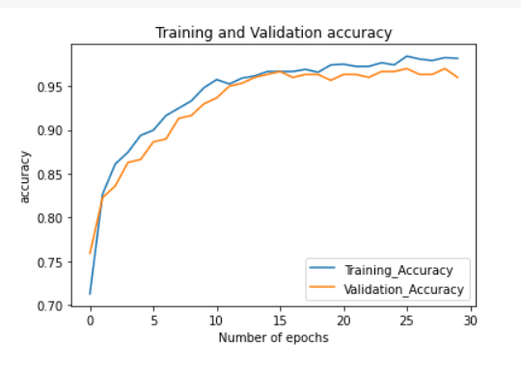
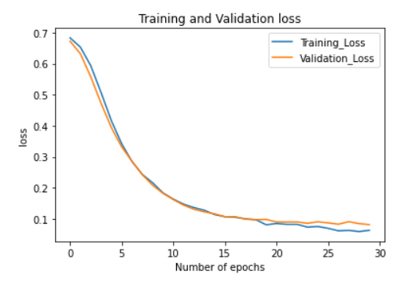
Model perfomance:DENSE model Accuracy:98.41

Slide 16
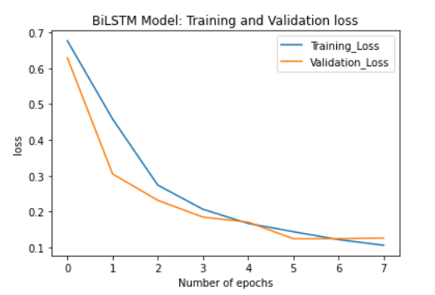
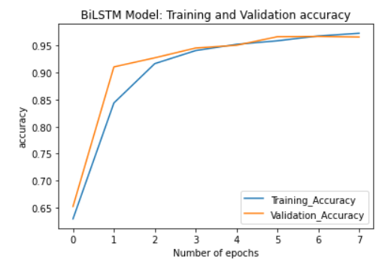
Model perfomence: BI-LSTM Model Accuracy:97.03

Slide 17
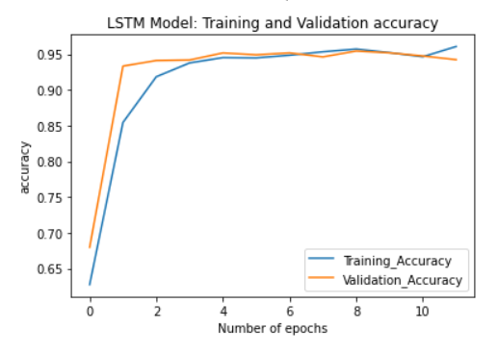
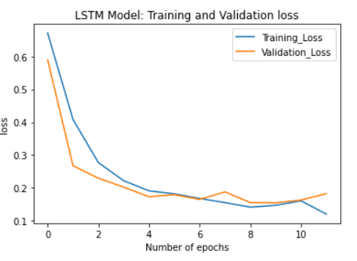
Model perfomance:LSTM Model Accuracy:96.08

Slide 18
Conclusion
In dataset 1, imbalancing problem affect the model and lowers the accuracy which is 57% in SVM model.
With balanced dataset 2, the same SVM model performed really well giving an accuracy a little over 90%.
Difference in accuracy because of a dataset is in balanced and imbalanced. In near future, we hope to research more on this topic.

Slide 19
Thank You...
Any Questions?

